Slide 1


Titolo presentazione sottotitolo
DCOP : Max Sum algorithm
Milano, XX mese 20XX
Intelligent Multiagent Systems
Crippa Dominic - 900367
Notes:
My project consisted in implement…
One possible solution to solve a…

Slide 2
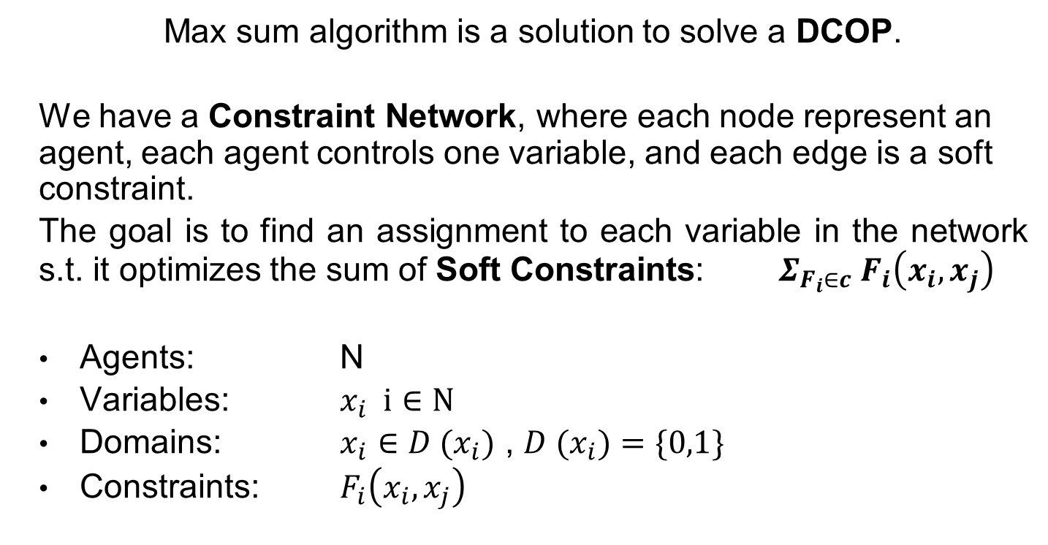
Goal of the project Max Sum
Max sum algorithm is a solution to solve a DCOP.
We have a Constraint Network, where each node represent an agent, each agent controls one variable, and each edge is a soft constraint.
The goal is to find an assignment to each variable in the network s.t. it optimizes the sum of Soft Constraints: $Σ_{F_{i}∈c}{ F}_{i}\left(x_{i},x_{j}\right)$
Agents: N
Variables: $x_{i} i∈N$
Domains: $x_{i}∈{D (x}_{i})$ , ${D (x}_{i})=\{0,1\}$
Constraints: $F_{i}\left(x_{i},x_{j}\right)$
Notes:
Model COP
Var, domains, const, function to optimize → goal
Model DCOP with Maxsum
Var, domains Booleans, const –> edge, function → sum of soft const
Const. network

Slide 3
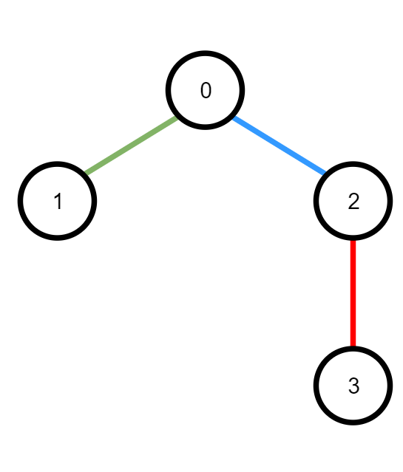
Abstract View Simple Example
x0 | x1 | F01
0 | 0 | 1
0 | 1 | 2
1 | 0 | 3
1 | 1 | 4
x0 | x2 | F02
0 | 0 | 0
0 | 1 | 7
1 | 0 | 4
1 | 1 | 1
x2 | x3 | F23
0 | 0 | 9
0 | 1 | 0
1 | 0 | 3
1 | 1 | 1
Notes:
Simple example on what I explained before

Slide 4
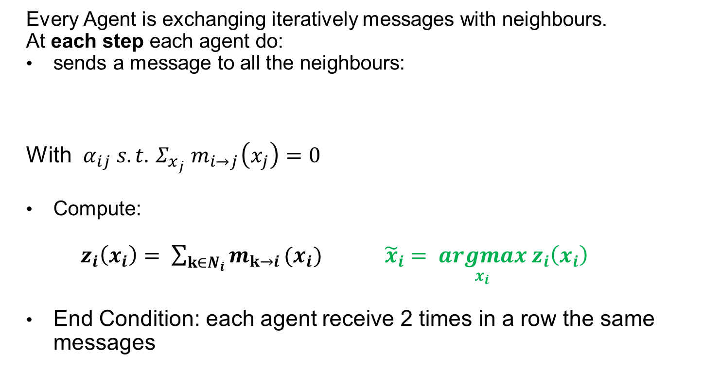

Goal of the project Max Sum
Every Agent is exchanging iteratively messages with neighbours.
At each step each agent do:
sends a message to all the neighbours:
With $α_{ij} s.t.{ Σ_{x_{j}} m}_{i→j}\left(x_{j}\right)=0$
Compute:
$z_{i}\left(x_{i}\right)= \sum_{k∈N_{i}}{m_{k→i}}(x_{i})$ ${\tilde{x}}_{i}= \underset{x_{i}}{argmax}{ z}_{i}\left(x_{i}\right)$
End Condition: each agent receive 2 times in a row the same messages
$$m_{i→j}\left(x_{j}\right)= α_{ij}+ \max_{x_{i}} ({ F}_{ij}\left(x_{i},x_{j}\right) + \sum_{A_{k}∈Neighbour\left\{i\right\}\backslash \{j\}}{{m }_{k→i} (x_{i})})$$
Notes:
It may seems very difficult, Conceptually is very simple
How work
End condition → intuitive
Constant for normalization
Constraint with the receiving agent
Sum of msg from neighbours

Slide 5
Comments
Convergence and Optimality:
- If the starting network is acyclic, the algorithm converges to the optimal solution.
- If the starting network is cyclic, the algorithm might not converge and if converges, it might converge to a local optimum.
The Size of Messages exchanged between the agent can be exponential

Slide 6
Abstract View Simple Example
x0 | x1 | F01
0 | 0 | 1
0 | 1 | 2
1 | 0 | 3
1 | 1 | 4
x0 | x2 | F02
0 | 0 | 0
0 | 1 | 7
1 | 0 | 4
1 | 1 | 1
x2 | x3 | F23
0 | 0 | 9
0 | 1 | 0
1 | 0 | 3
1 | 1 | 1

Slide 7
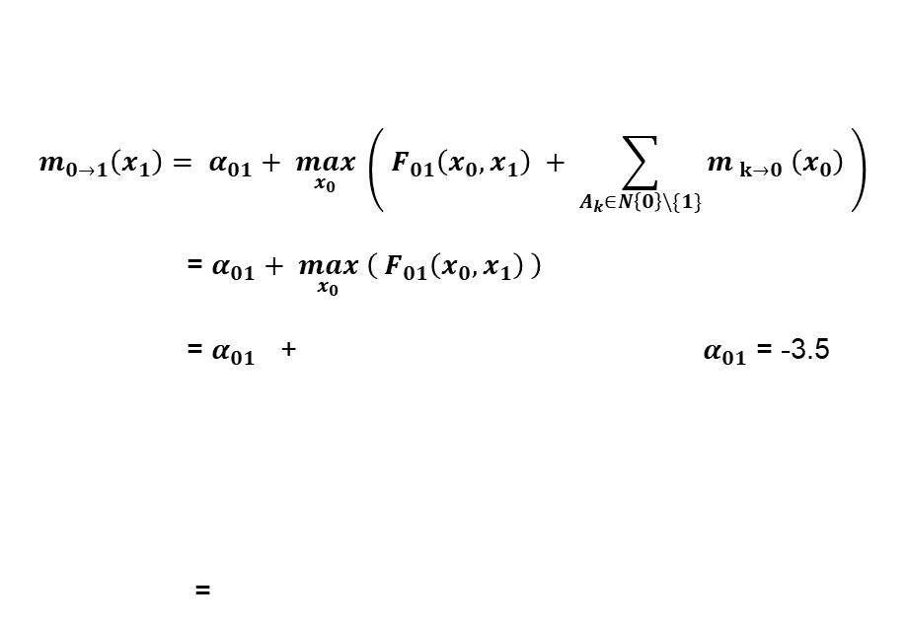
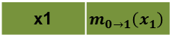
Abstract View Step 1
$$m_{0→1}\left(x_{1}\right)= α_{01}+ \max_{x_{0}} \left({ F}_{01}\left(x_{0},x_{1}\right) + \sum_{A_{k}∈N\left\{0\right\}\backslash \{1\}}{{m }_{k→0} \left(x_{0}\right)} \right)$$
= $α_{01}+ \max_{x_{0}} \left({ F}_{01}\left(x_{0},x_{1}\right) \right)$
= $α_{01}$ + $α_{01}$ = -3.5
=
x1 | F 01
0 | 3
1 | 4
x1 | $$m_{0→1}\left(x_{1}\right)$$
0 | -0.5
1 | +0.5

Slide 8
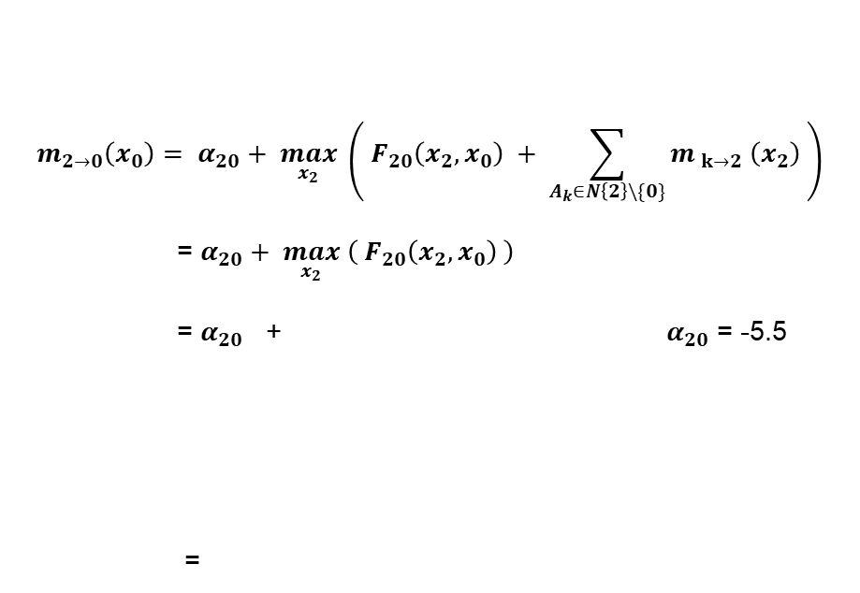
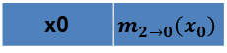
Abstract View Step 1
$$m_{2→0}\left(x_{0}\right)= α_{20}+ \max_{x_{2}} \left({ F}_{20}\left(x_{2},x_{0}\right) + \sum_{A_{k}∈N\left\{2\right\}\backslash \{0\}}{{m }_{k→2} \left(x_{2}\right)} \right)$$
= $α_{20}+ \max_{x_{2}} \left({ F}_{20}\left(x_{2},x_{0}\right) \right)$
= $α_{20}$ + $α_{20}$ = -5.5
=
x0 | F 20
0 | 7
1 | 4
x0 | $$m_{2→0}\left(x_{0}\right)$$
0 | 1.5
1 | -1.5

Slide 9
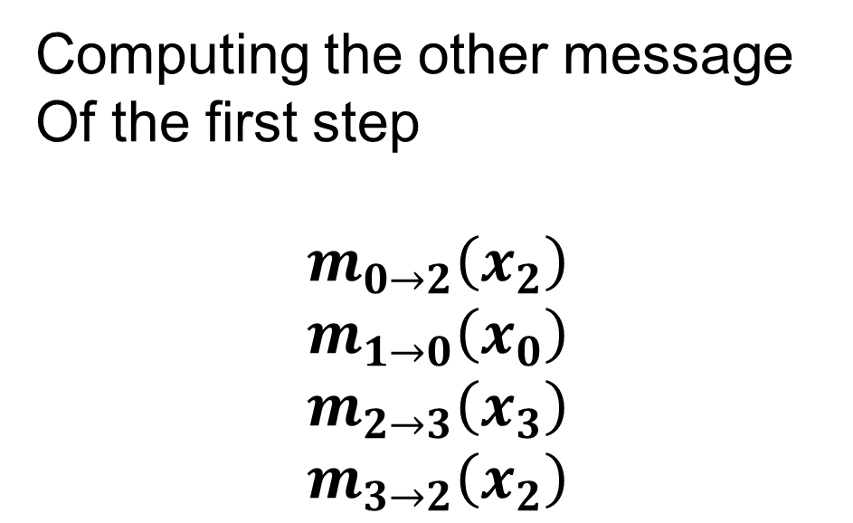
Abstract View Step 1
Computing the other message
Of the first step
$$m_{0→2}\left(x_{2}\right)$$
$$m_{1→0}\left(x_{0}\right)$$
$$m_{2→3}\left(x_{3}\right)$$
$$m_{3→2}\left(x_{2}\right)$$

Slide 10
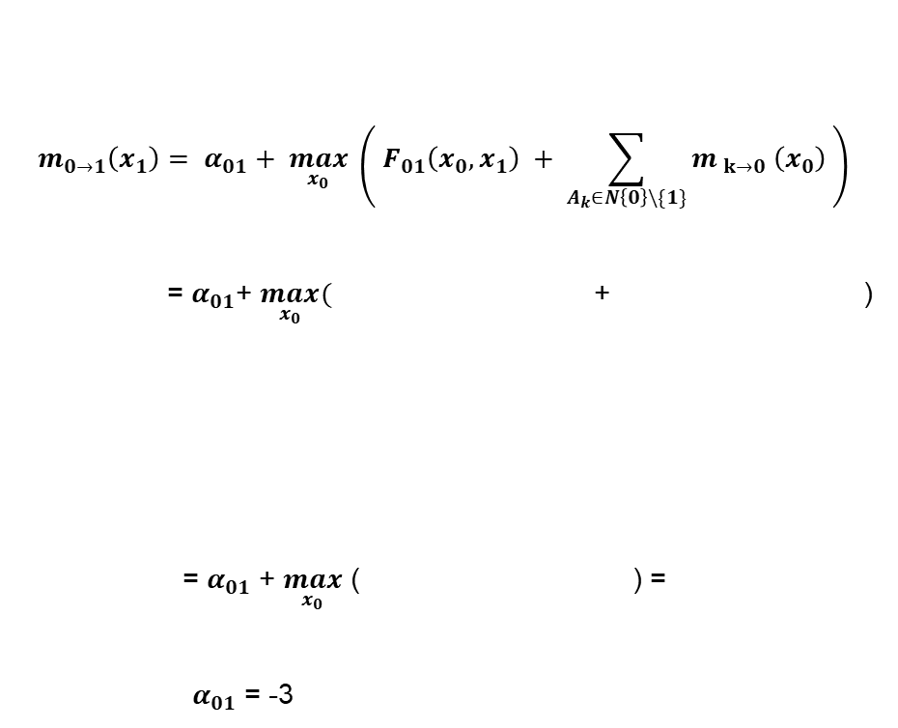
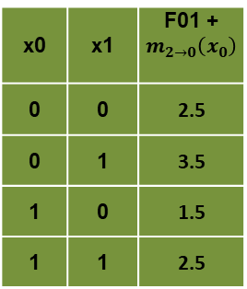
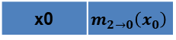
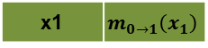
Abstract View Step 2
$$m_{0→1}\left(x_{1}\right)= α_{01}+ \max_{x_{0}} \left({ F}_{01}\left(x_{0},x_{1}\right) + \sum_{A_{k}∈N\left\{0\right\}\backslash \{1\}}{{m }_{k→0} \left(x_{0}\right)} \right)$$
= $α_{01}$+ $\max_{x_{0}}($ + )
= $α_{01}$ + $\max_{x_{0}}$ ( ) =
${ α}_{01}$ = -3
x0 | x1 | F01
0 | 0 | 1
0 | 1 | 2
1 | 0 | 3
1 | 1 | 4
x0 | $$m_{2→0}\left(x_{0}\right)$$
0 | 1.5
1 | -1.5
x0 | x1 | F01 + $m_{2→0}\left(x_{0}\right)$
0 | 0 | 2.5
0 | 1 | 3.5
1 | 0 | 1.5
1 | 1 | 2.5
x1 | $$m_{0→1}\left(x_{1}\right)$$
0 | -0.5
1 | +0.5

Slide 11
Abstract View Step 2
And so on….

